Slide 1
AWS CLOUD SECURITY OPERATIONS
CSPM, Threat Detection
& Automated Remediation
POSTURE CHANGE
42%
baseline
A practical security workflow built around Security Hub, AWS Config,
Security Lake, Athena, EventBridge and Lambda.
↓
75%
observed later
Prepared by Vedant Kale
30 September 2026
Shreik Global • Cloud Engineer • Level 3

Slide 2
OVERVIEW
What the project was designed to prove
02
The goal was not just to collect findings. The workflow was built to show what happens after a finding appears.
DETECT
PRIORITISE
REMEDIATE
Security Hub + AWS Config continuously
surface posture issues.
Risk is considered using severity, exposure
and resource sensitivity.
High-confidence S3 exposure is handled
through EventBridge + Lambda.
PREVENT
MEASURE
S3 Block Public Access makes the same
drift harder to reintroduce.
The CSPM score and findings are captured
again after the changes.
Environment: AWS ap-south-1 (Mumbai) • Security Hub FSBP • AWS Config • Security Lake/Athena • EventBridge • Lambda
SHREIK GLOBAL • AWS CLOUD SECURITY OPERATIONS
Vedant Kale

Slide 3
DESIGN
Control architecture used in the exercise
03
AWS SOURCES
→
SECURITY HUB
→
CONFIG / SECURITY LAKE
→
RESPONSE
S3 • EC2 • IAM
VPC Flow Logs • CloudTrail
FSBP controls
Findings + posture
Config rules
Athena hunting
EventBridge
→ Lambda → AWS API
Evidence loop
Finding → risk context → remediation decision → control re-check → posture score
The same sequence can be repeated for future posture checks and audit evidence.
SHREIK GLOBAL • AWS CLOUD SECURITY OPERATIONS
Vedant Kale

Slide 4
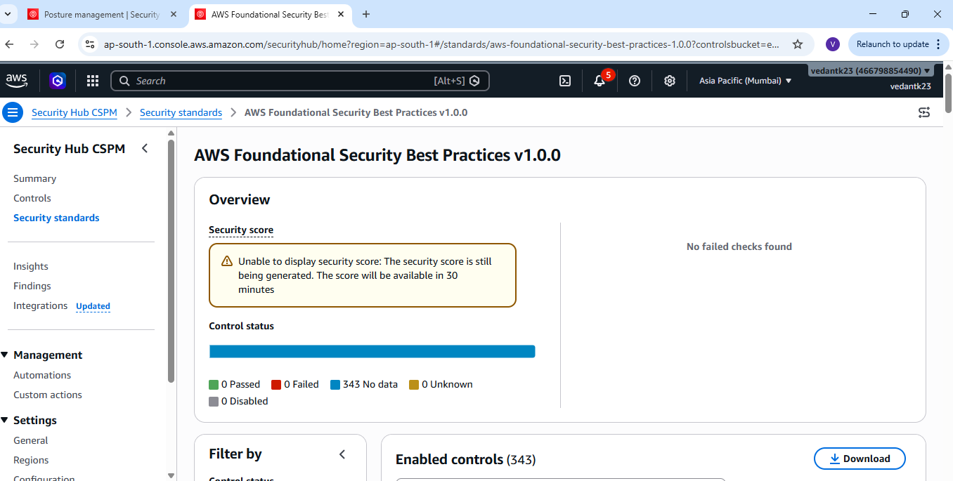
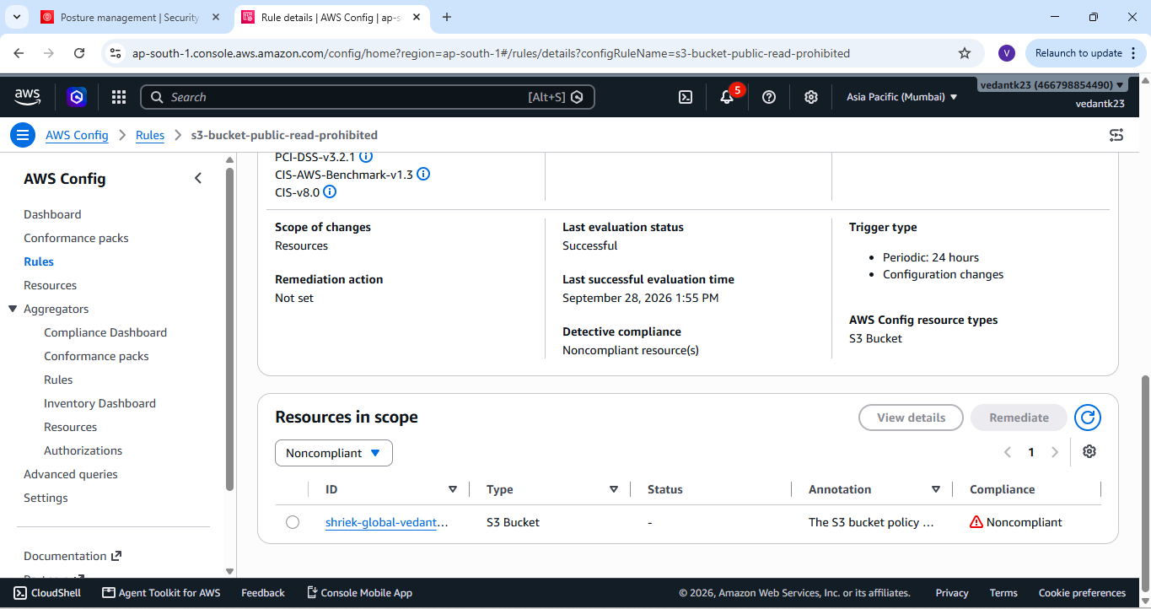
STAGE 1
Stage 1 — Security Hub & Config baseline
04
STAGE 1
Security Hub FSBP standard / control view
AWS Config recorder and resource coverage
SHREIK GLOBAL • AWS CLOUD SECURITY OPERATIONS
Vedant Kale

Slide 5
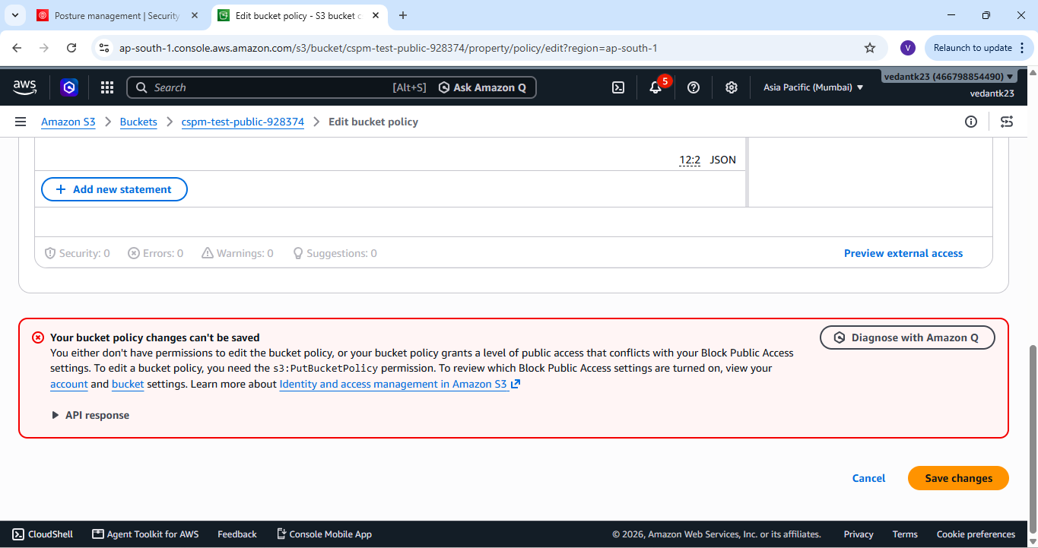
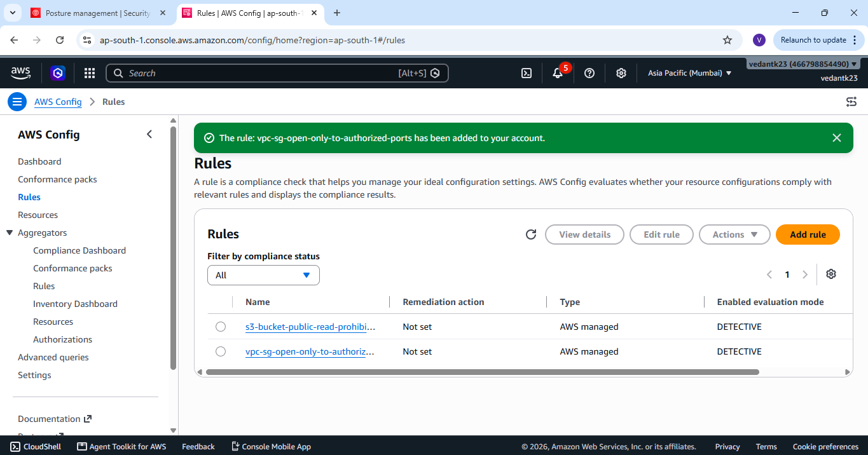
STAGE 1
Stage 1 — Config rules and controlled drift
05
STAGE 1
S3 public-access test / policy warning
Config rule view and evaluation state
SHREIK GLOBAL • AWS CLOUD SECURITY OPERATIONS
Vedant Kale

Slide 6
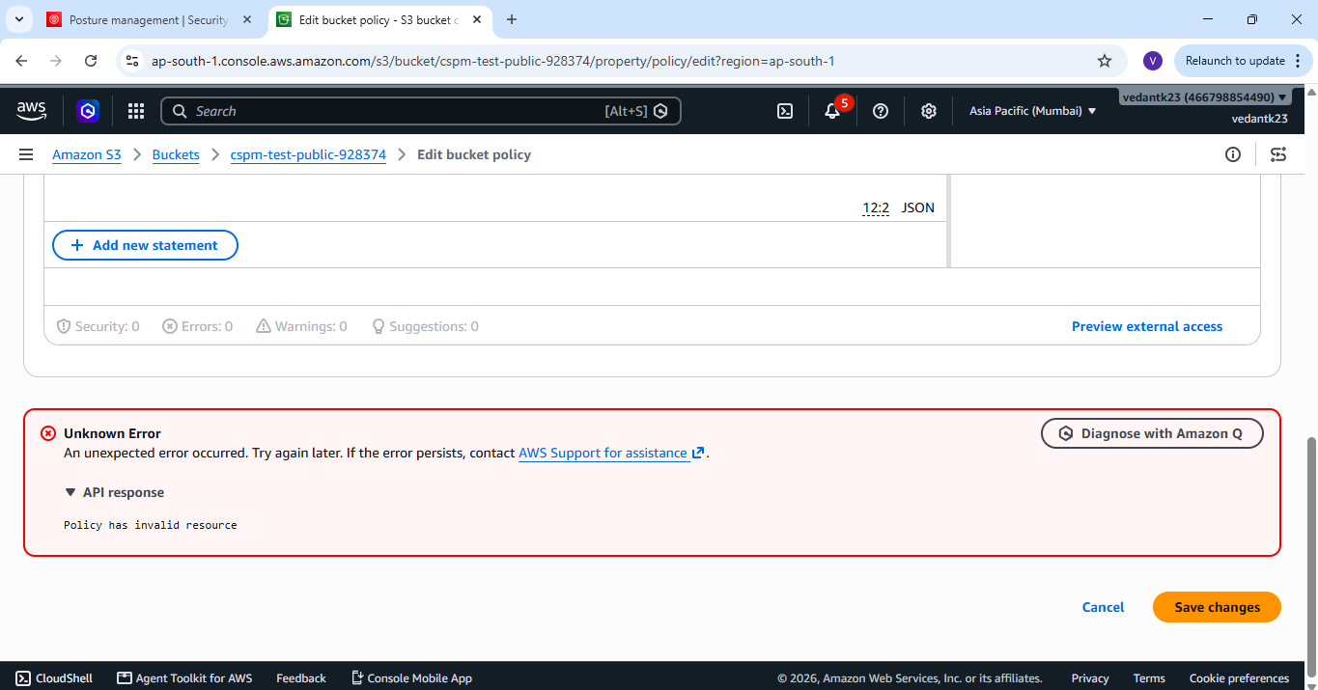
STAGE 1
Stage 1 — Preventive behaviour in the S3 test
06
STAGE 1
Public policy attempt blocked
Same test showing the preventive warning
SHREIK GLOBAL • AWS CLOUD SECURITY OPERATIONS
Vedant Kale

Slide 7
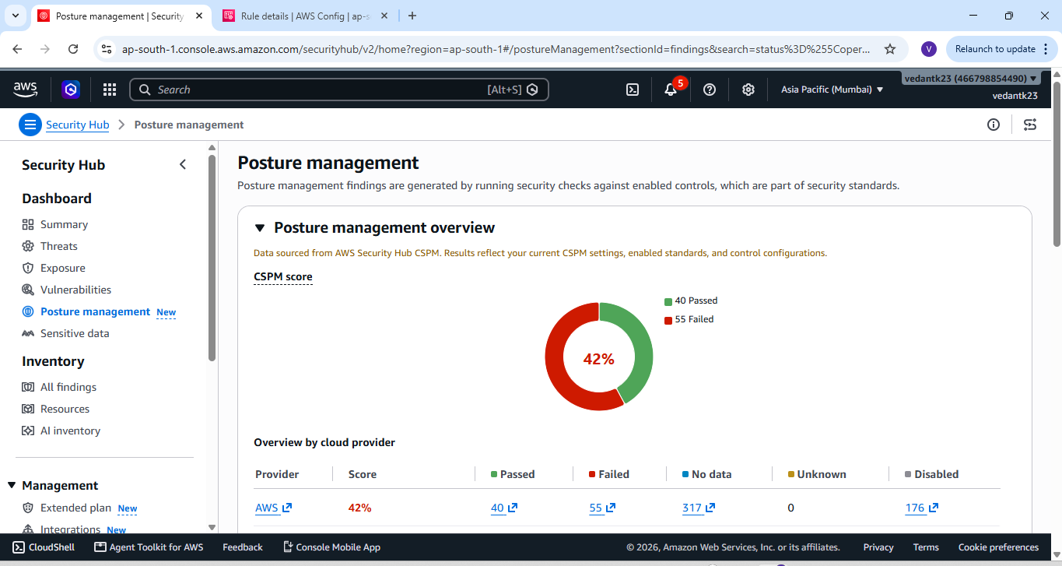
STAGE 1
Baseline posture — where the account started
07
42%
CSPM baseline score
40
55
Passed controls
Failed controls
317
No data
This was the observed starting point before the later remediation/validation cycle.
SHREIK GLOBAL • AWS CLOUD SECURITY OPERATIONS
Vedant Kale

Slide 8
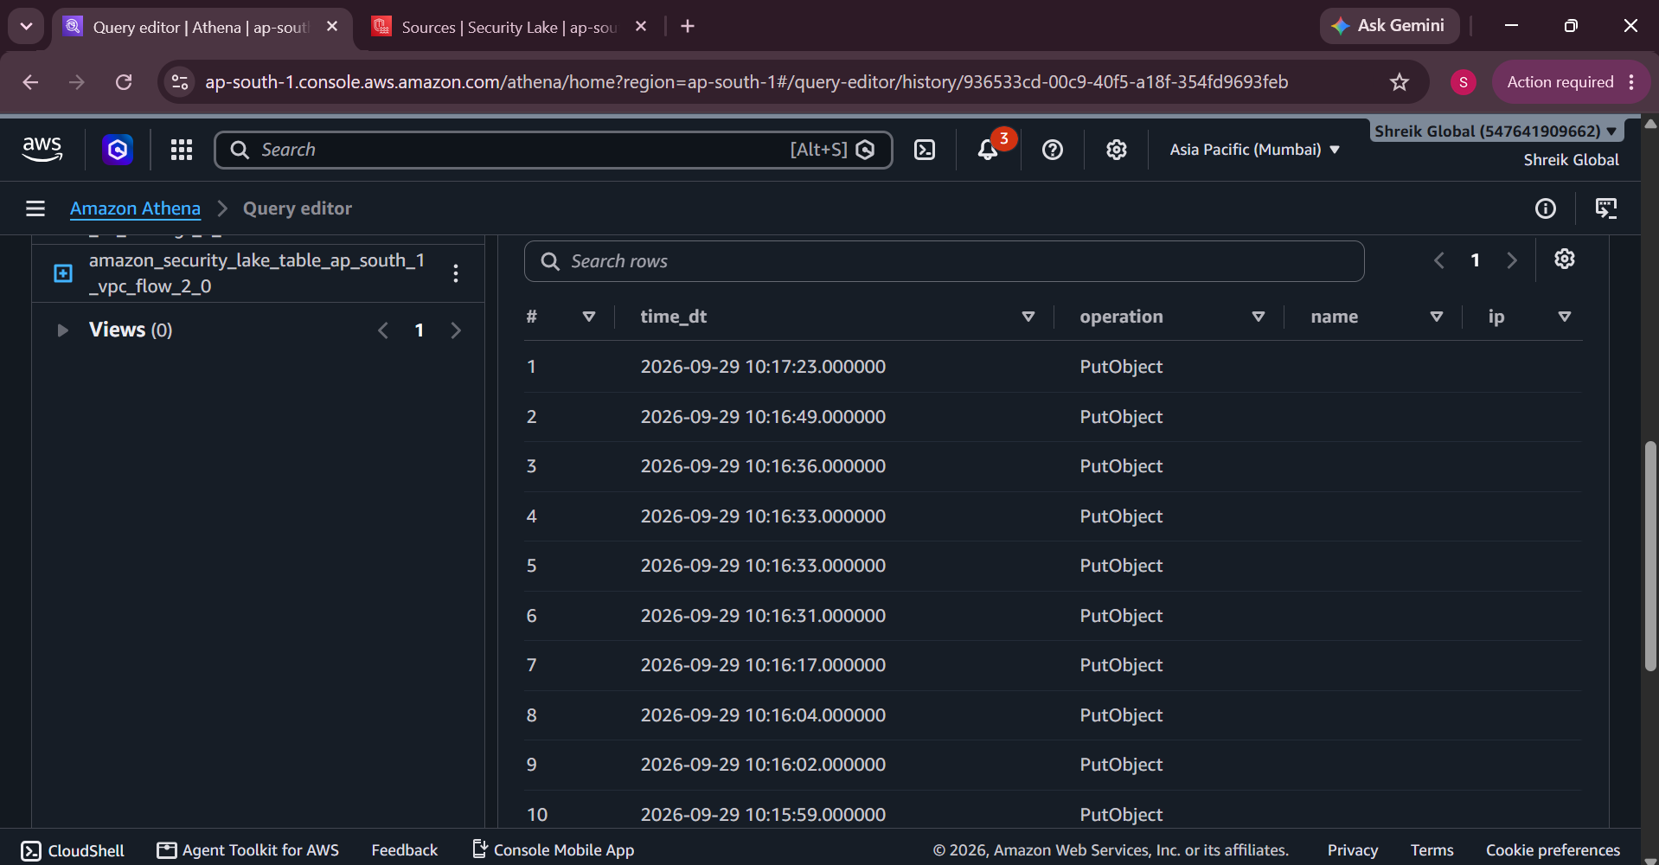
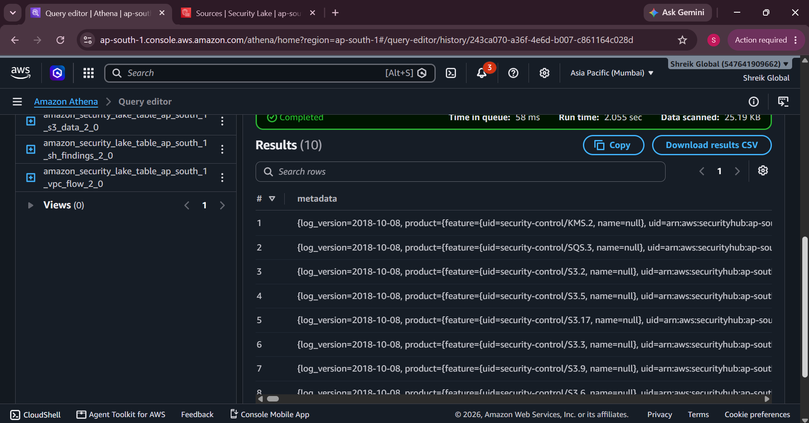
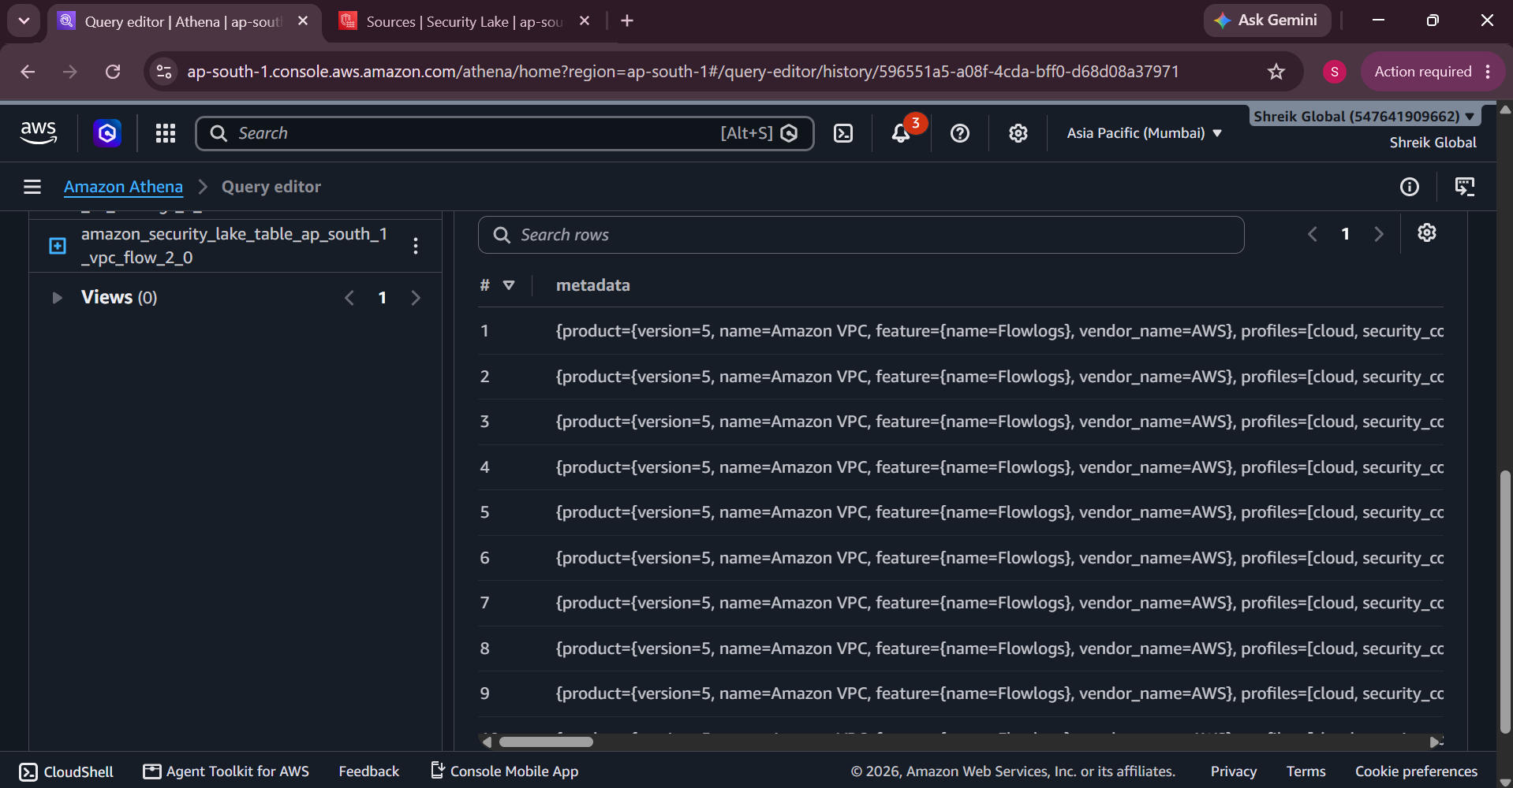
STAGE 2
Stage 2 — Security Lake / Athena evidence
08
STAGE 2
S3 data events — PutObject results
Security Hub findings table
VPC Flow Logs table
SHREIK GLOBAL • AWS CLOUD SECURITY OPERATIONS
Vedant Kale

Slide 9
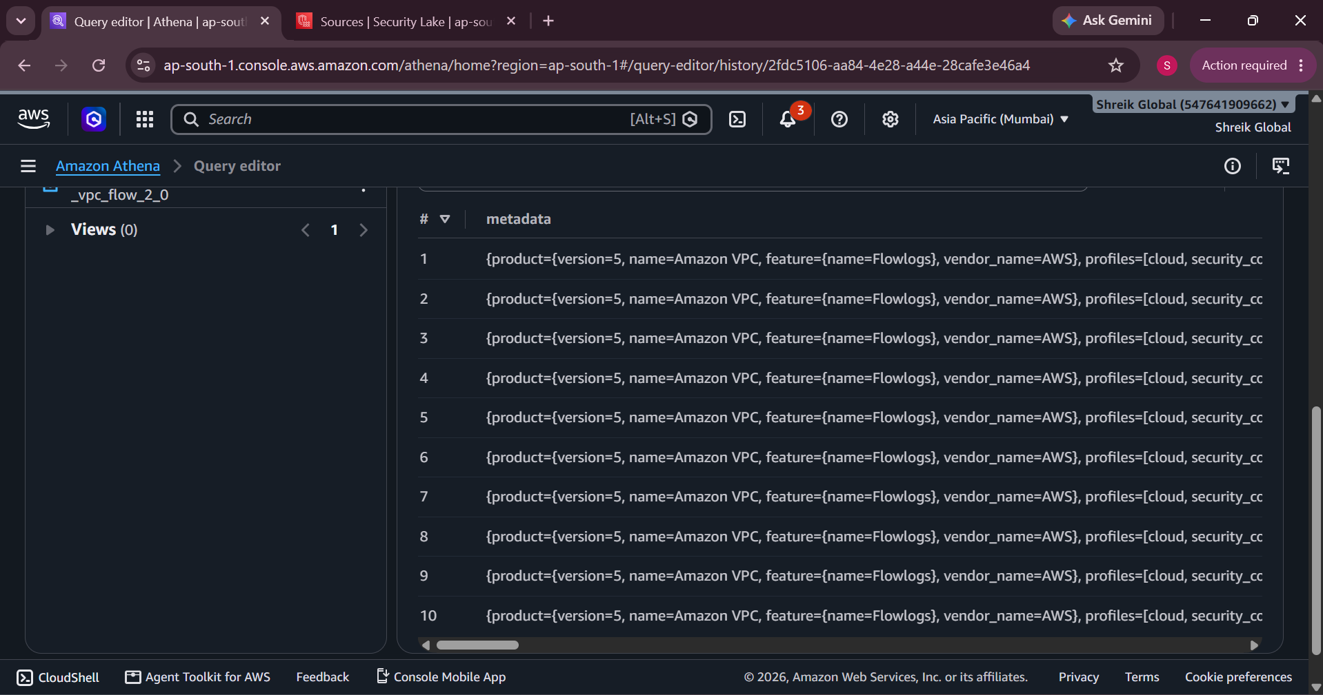
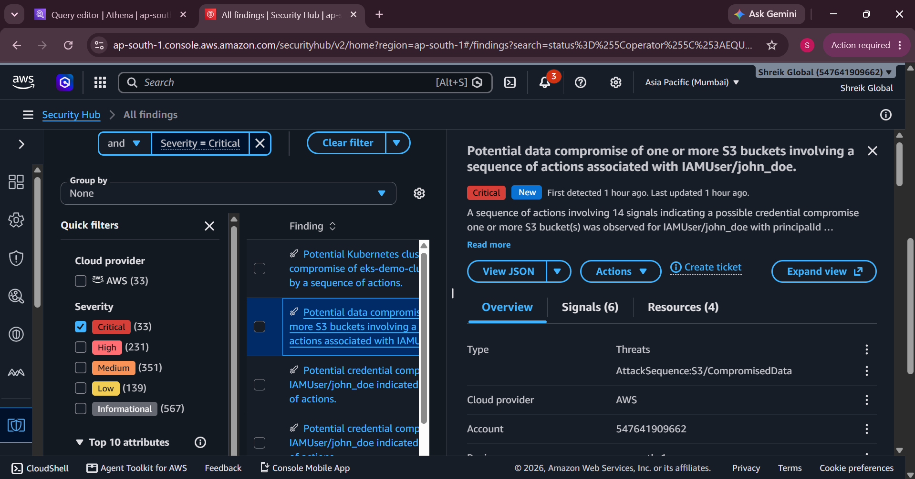
STAGE 2
Stage 2 — Findings and network context
09
STAGE 2
Additional VPC Flow Logs result set
Critical Security Hub finding — S3 activity sequence
SHREIK GLOBAL • AWS CLOUD SECURITY OPERATIONS
Vedant Kale

Slide 10
STAGE 2
Risk-based prioritisation
10
Risk score = Severity × Exposure × Resource Sensitivity
Finding
Severity
Exposure
Sensitivity
Risk
Why this mattered
Public S3 bucket
5
5
4
100
• Severity alone was not used as the final ordering.
• Internet exposure increased the risk of a finding.
• Sensitive resources received more weight.
• High-confidence configuration exposures were candidates for automation.
Unrestricted high-risk SG
5
5
4
100
Public EBS snapshot access
4
4
4
64
Public SSM document sharing
5
3
4
60
ECS root filesystem writable
4
3
4
48
The model is a project scoring method used to make prioritisation repeatable.
Inspector EC2 scanning disabled
4
2
3
24
SHREIK GLOBAL • AWS CLOUD SECURITY OPERATIONS
Vedant Kale

Slide 11
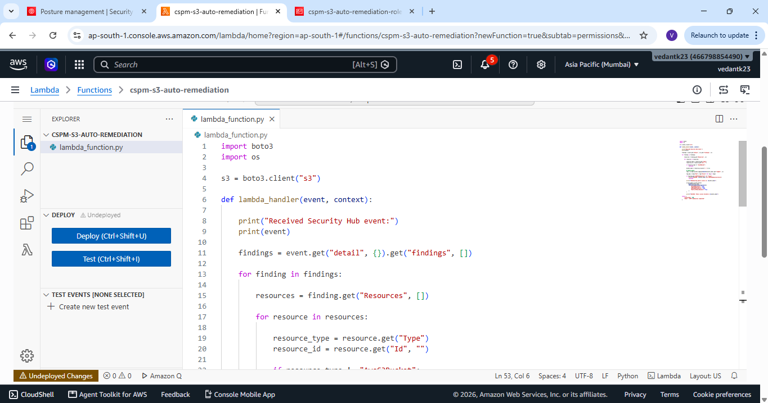
STAGE 3
Stage 3 — Automated remediation design
11
Security Hub finding
→
EventBridge
→
Lambda
→
S3 API change
→
Re-check
Safety built into the flow
• Check the finding before making a change.
• Respect the protected tag: CSPM-Remediation=false.
• Only high-confidence S3 exposure is auto-remediated.
• Other business-sensitive changes can be escalated for review.
SHREIK GLOBAL • AWS CLOUD SECURITY OPERATIONS
Vedant Kale

Slide 12
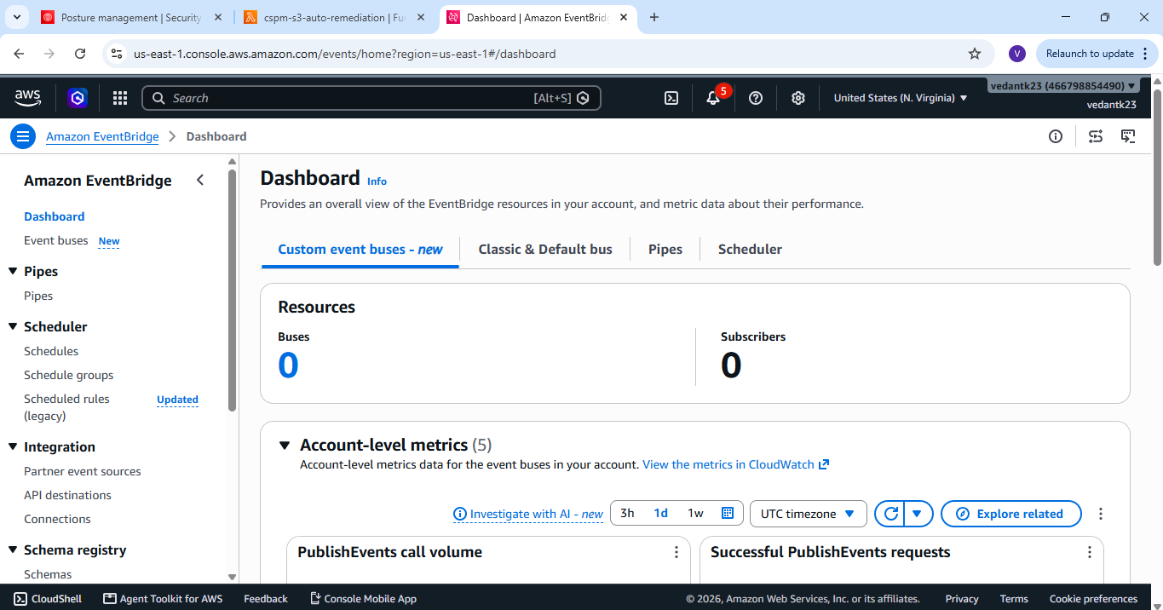
STAGE 3
Stage 3 — Lambda and EventBridge evidence
12
STAGE 3
Lambda remediation code in ap-south-1
EventBridge rule / target configuration
Evidence shows the implementation components used for the remediation path.
SHREIK GLOBAL • AWS CLOUD SECURITY OPERATIONS
Vedant Kale

Slide 13
STAGE 4
Stage 4 — Prevention and detective controls
13
STAGE 4
Preventive S3 public-policy test
Preventive S3 test — warning state
AWS Config rules view
The S3 Block Public Access control prevents the tested public configuration from being introduced while Config/Security Hub provide detective coverage.
SHREIK GLOBAL • AWS CLOUD SECURITY OPERATIONS
Vedant Kale

Slide 14
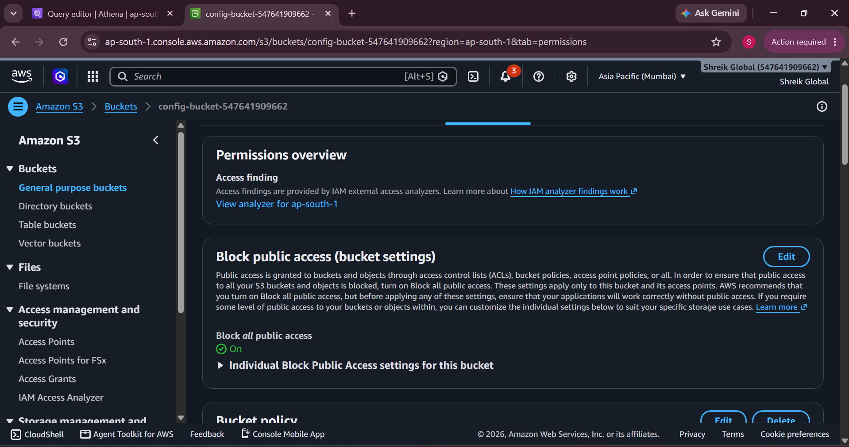
STAGE 5
Stage 5 — Remediation verification on the bucket
14
Verification point
Block all public access
ON
• The bucket remained protected against public access.
• This is the control state used for the post-remediation check.
• Evidence is taken from the S3 Permissions page.
SHREIK GLOBAL • AWS CLOUD SECURITY OPERATIONS
Vedant Kale

Slide 15
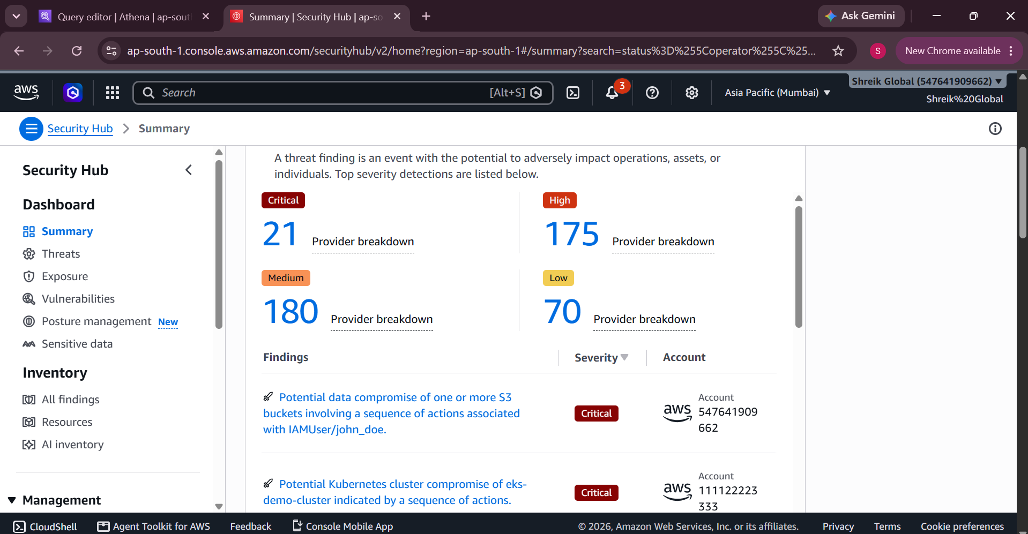
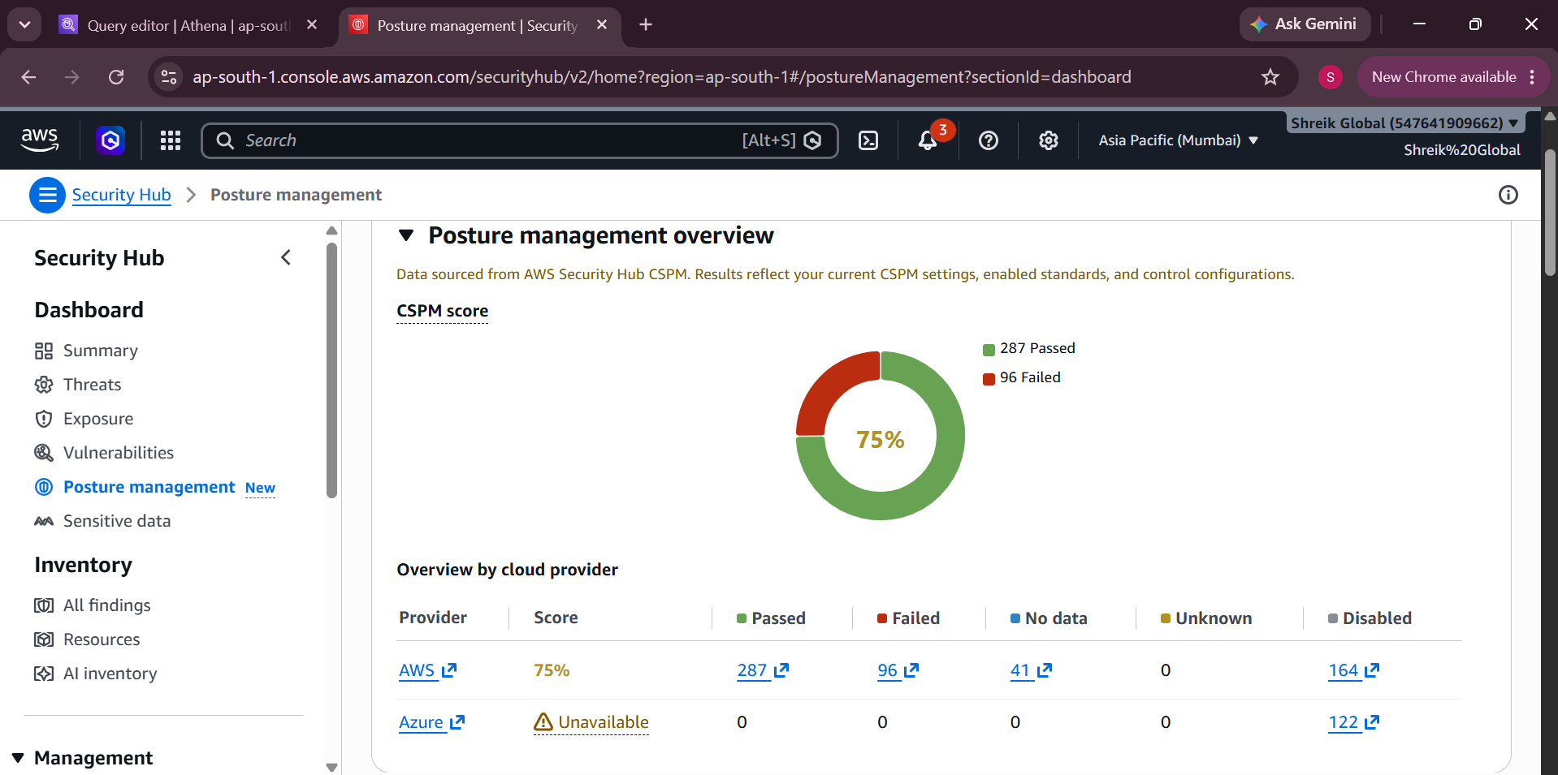
STAGE 5
Stage 5 — Current Security Hub findings view
15
STAGE 5
Current severity summary: 21 Critical / 175 High / 180 Medium / 70 Low
Current CSPM posture: 75% (287 passed / 96 failed)
SHREIK GLOBAL • AWS CLOUD SECURITY OPERATIONS
Vedant Kale

Slide 16
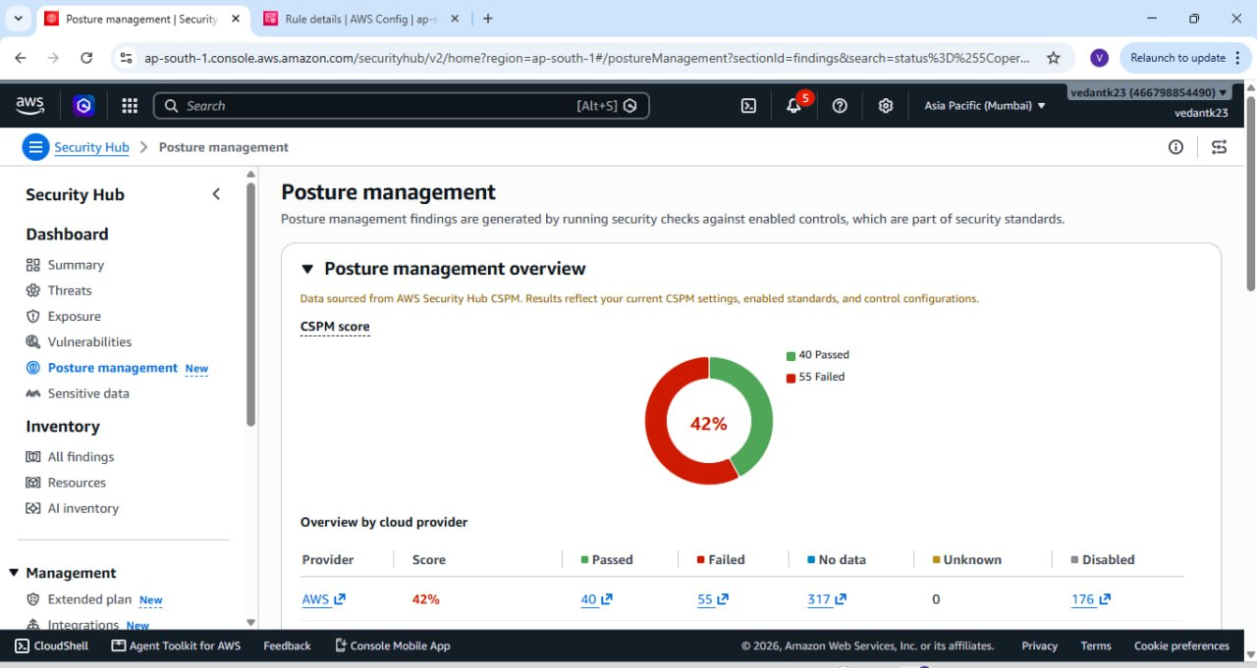
STAGE 5
Before → after: posture score evidence
16
BEFORE
LATER OBSERVED
→
42%
75%
baseline
post-remediation / later measurement
SHREIK GLOBAL • AWS CLOUD SECURITY OPERATIONS
Vedant Kale

Slide 17
RESULT
What changed during the exercise
17
42% → 75%
287
96
CSPM score observed across the exercise
Passed controls at the later posture view
Failed controls at the later posture view
Evidence-backed outcome
• Security Hub provided the central posture and findings view.
• Athena queries demonstrated that Security Lake data was available for S3 activity, Security Hub findings and VPC Flow Logs.
• S3 Block Public Access was verified in the final bucket state.
• The later CSPM view showed a materially different posture score than the original 42% baseline.
SHREIK GLOBAL • AWS CLOUD SECURITY OPERATIONS
Vedant Kale

Slide 18
EVIDENCE
Evidence map — what each screenshot proves
18
01–04
Security Hub / Config setup
Standard, controls, recorder and resource coverage.
05–06
Controlled S3 drift
Public-policy test and preventive response.
07
Baseline posture
42% CSPM starting score.
08–12
Security Lake / Athena
S3 data events, Security Hub findings and VPC Flow Logs.
13–15
Response path
Lambda remediation code and EventBridge configuration.
16–18
Prevention / Config
S3 preventive test and Config rule evidence.
19
Final S3 state
Block all public access = ON.
20–22
Final posture
Security Hub summary + 75% posture + 42% comparison.
22 visual evidence items are carried into this final deck, with the screenshots grouped by the stage they support.
SHREIK GLOBAL • AWS CLOUD SECURITY OPERATIONS
Vedant Kale

Slide 19
CLOSE-OUT
Submission-ready checklist
19
✓
Detection
Security Hub + Config baseline and deliberate misconfiguration evidence
✓
Threat hunting
Security Lake / Athena queries across multiple source tables
✓
Prioritisation
Severity × Exposure × Resource Sensitivity model
✓
Response
EventBridge → Lambda remediation path with safety guard
✓
Prevention
S3 Block Public Access verified in the final state
✓
Reporting
Baseline and later CSPM score captured with screenshots
Final note: the report uses the screenshots as the primary evidence and keeps the narrative tied to what was actually observed.
SHREIK GLOBAL • AWS CLOUD SECURITY OPERATIONS
Vedant Kale

Slide 20
CLOSING SUMMARY
Detect → Prioritise → Remediate
→ Prevent → Measure
Key evidence
• 42% baseline posture
• Security Lake / Athena hunting evidence
• EventBridge + Lambda response path
• S3 preventive control verified
• 75% later CSPM posture
The exercise turns the CSPM requirement into a repeatable security workflow rather than a one-time compliance check.
Prepared by Vedant Kale
AWS Cloud Engineer
AWS Cloud Security Operations • CSPM Assessment

